Slide 1
Flag Representation Hypothesis
Pedro Valois, Lincon Souza, Erica Shimomoto, Kazuhiro Fukui

Slide 2
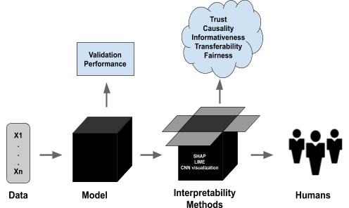
Interpretability
Fostering Trust

Slide 3
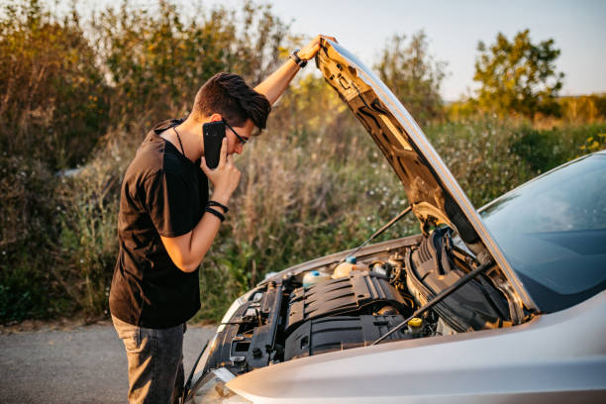
Interpretability
We need to fix when it breaks.
?
?
?

Slide 4
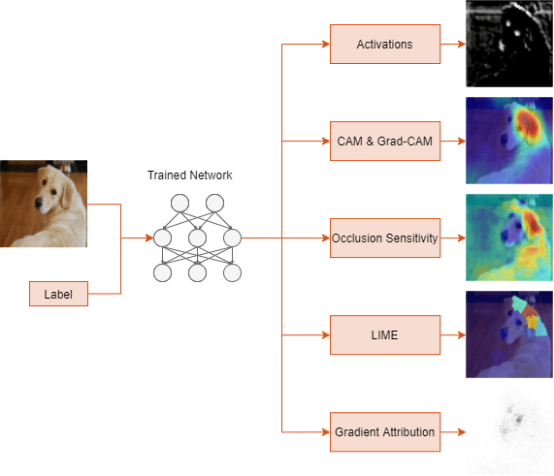
Interpretability in Vision
Attribution: Where is the model looking at?

Slide 5
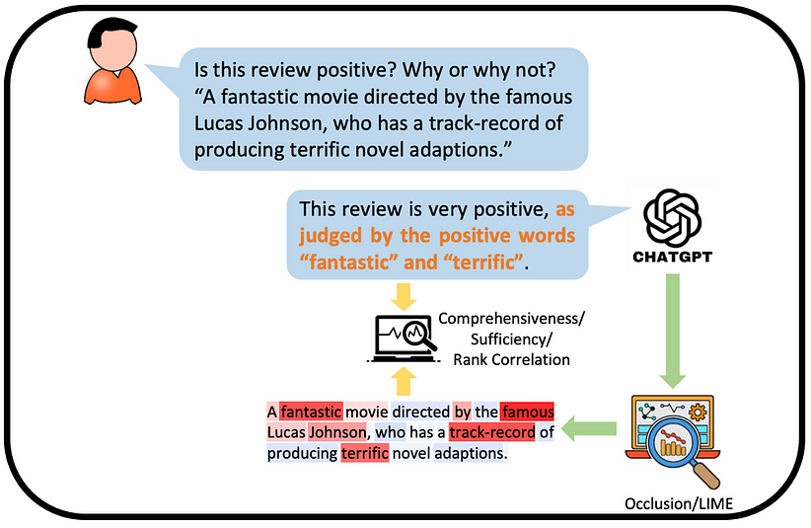
Interpretability in Language
Attribution is limited to classifications.
Self-Explanation
Attribution

Slide 6
What is this Research
LLM Interpretability is difficult.
We model LLM features as Flag Subspaces.
We are able to better understand and control LLMs with this proposal.

Slide 7
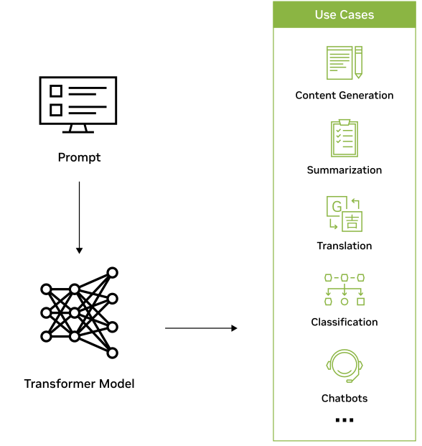
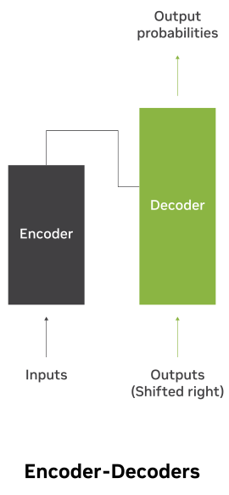
What are Large Language Models?

Slide 8
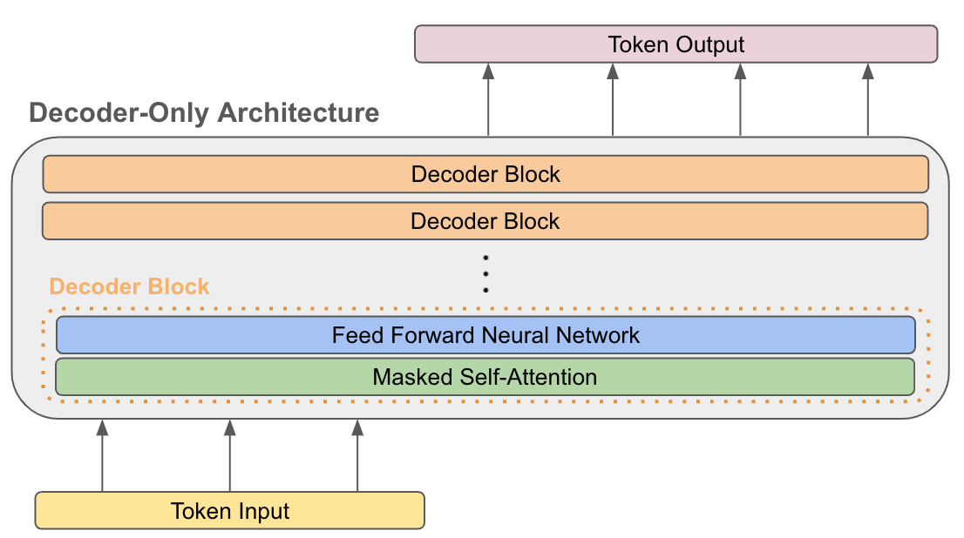
Decoder Only LLMs
jump
ed
over
him
The
red
fox

Slide 9
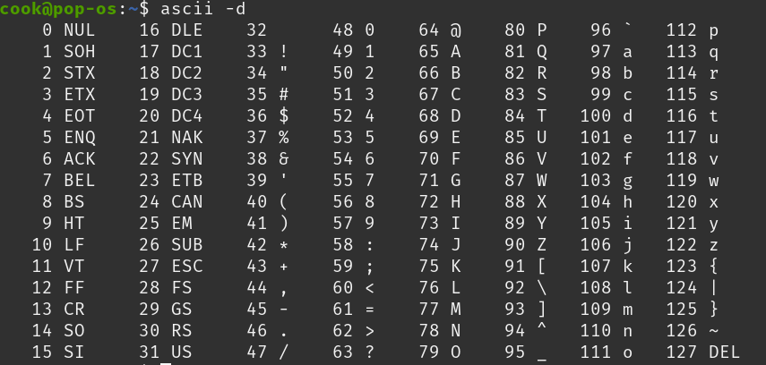
What is Tokenization?
How computers process text?

Slide 10
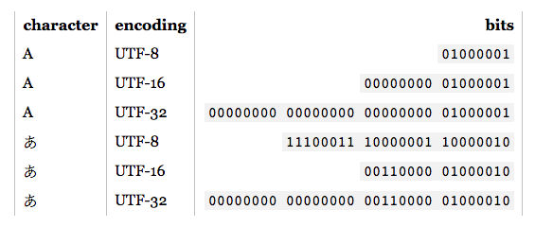
What is Tokenization?
How computers process text?
Vocabulary

Slide 11
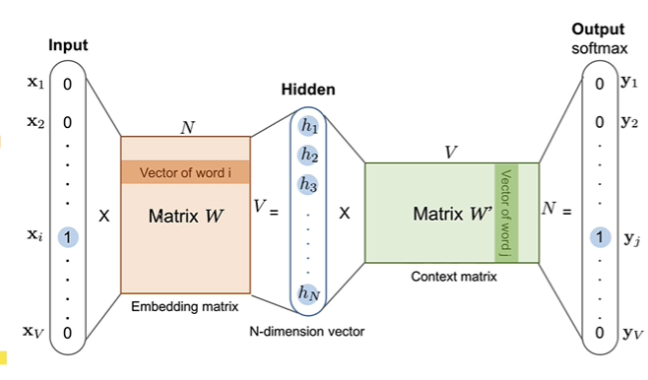
What is Tokenization?
Each token becomes a unique vector
a
a
b
b
i
i
Unembedding matrix
Z
Z

Slide 12
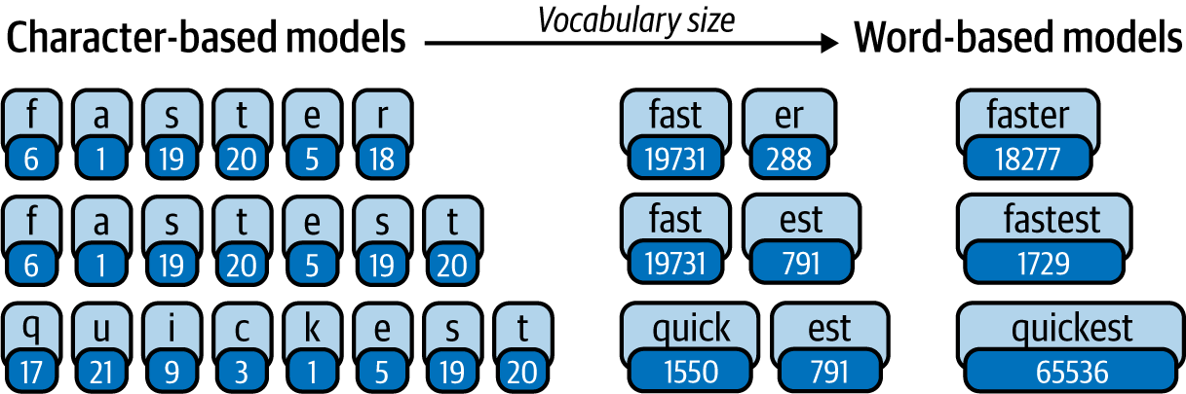
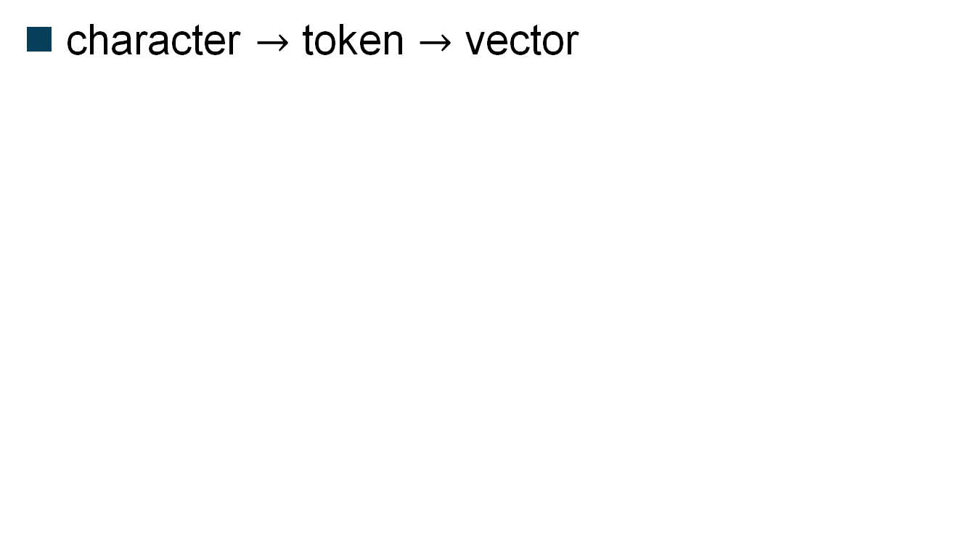
What is Tokenization?
character $→$ token $→$ vector
Not enough dimensions!

Slide 13
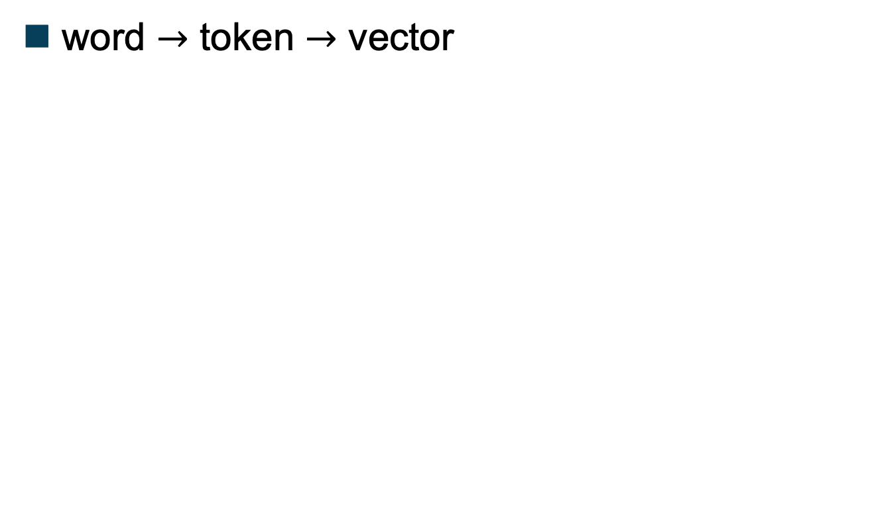
What is Tokenization?
word $→$ token $→$ vector
Not enough memory!

Slide 14
What is Tokenization?
We need to increase the Vocabulary
But pay attention to the memory!
Not enough information
Too much information
Words are broken into pieces

Slide 15
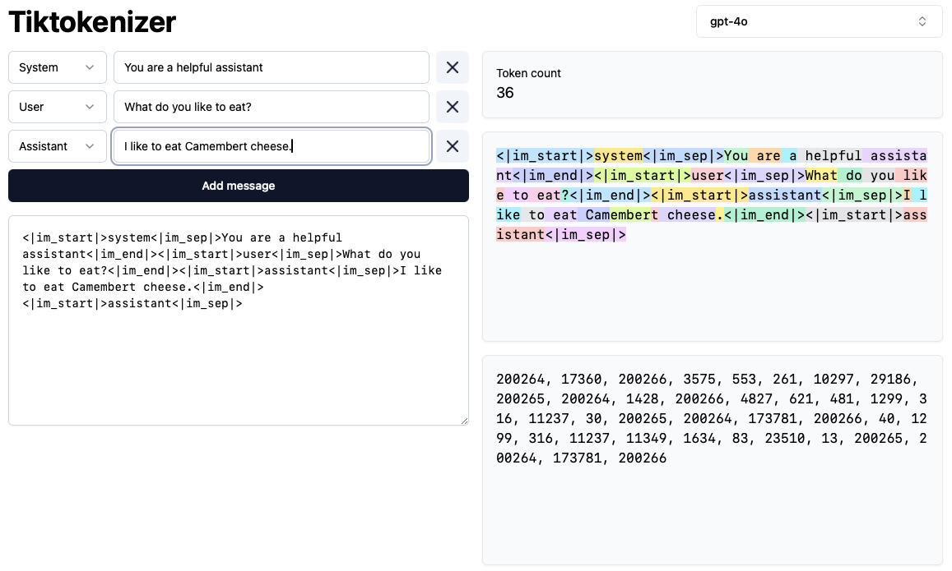
What is Tokenization?
Camembert

Slide 16
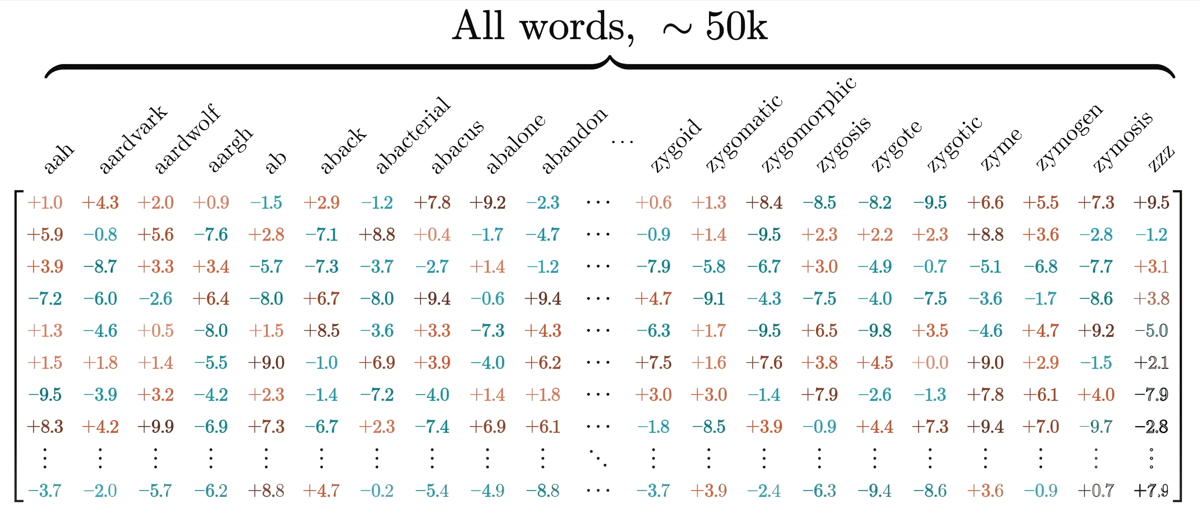
Embedding\Unembedding Matrices
All Tokens

Slide 17
What is Tokenization?
Unembedding matrix
Output is decoded into tokens

Slide 18
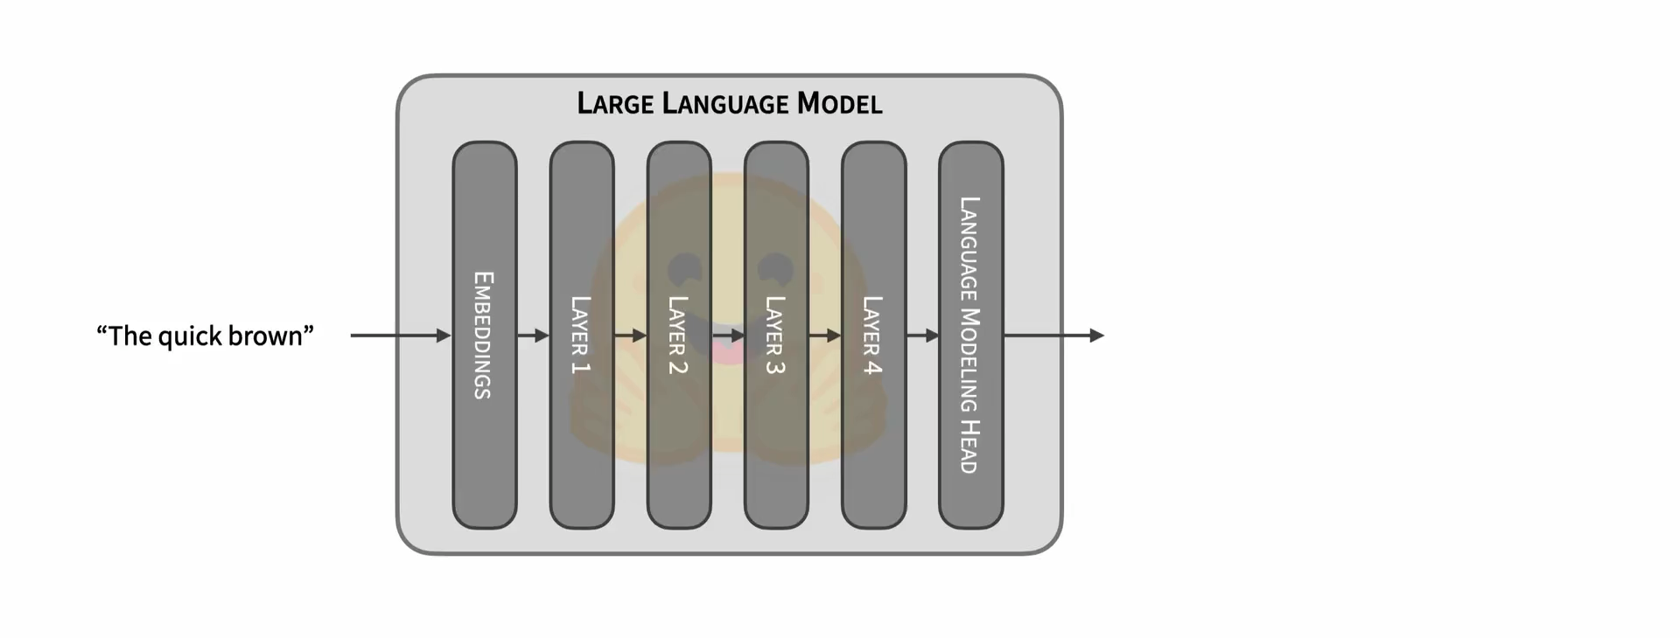
Next token prediction
The model predicts the probability for each possible token.

Slide 19
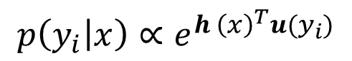
What is Tokenization?
Unembedding matrix
$$p\left(y_{i} | x\right)∝e^{h {\left(x\right)}^{T}u(y_{i})}$$

Slide 20
What these vectors represent?
All Tokens

Slide 21
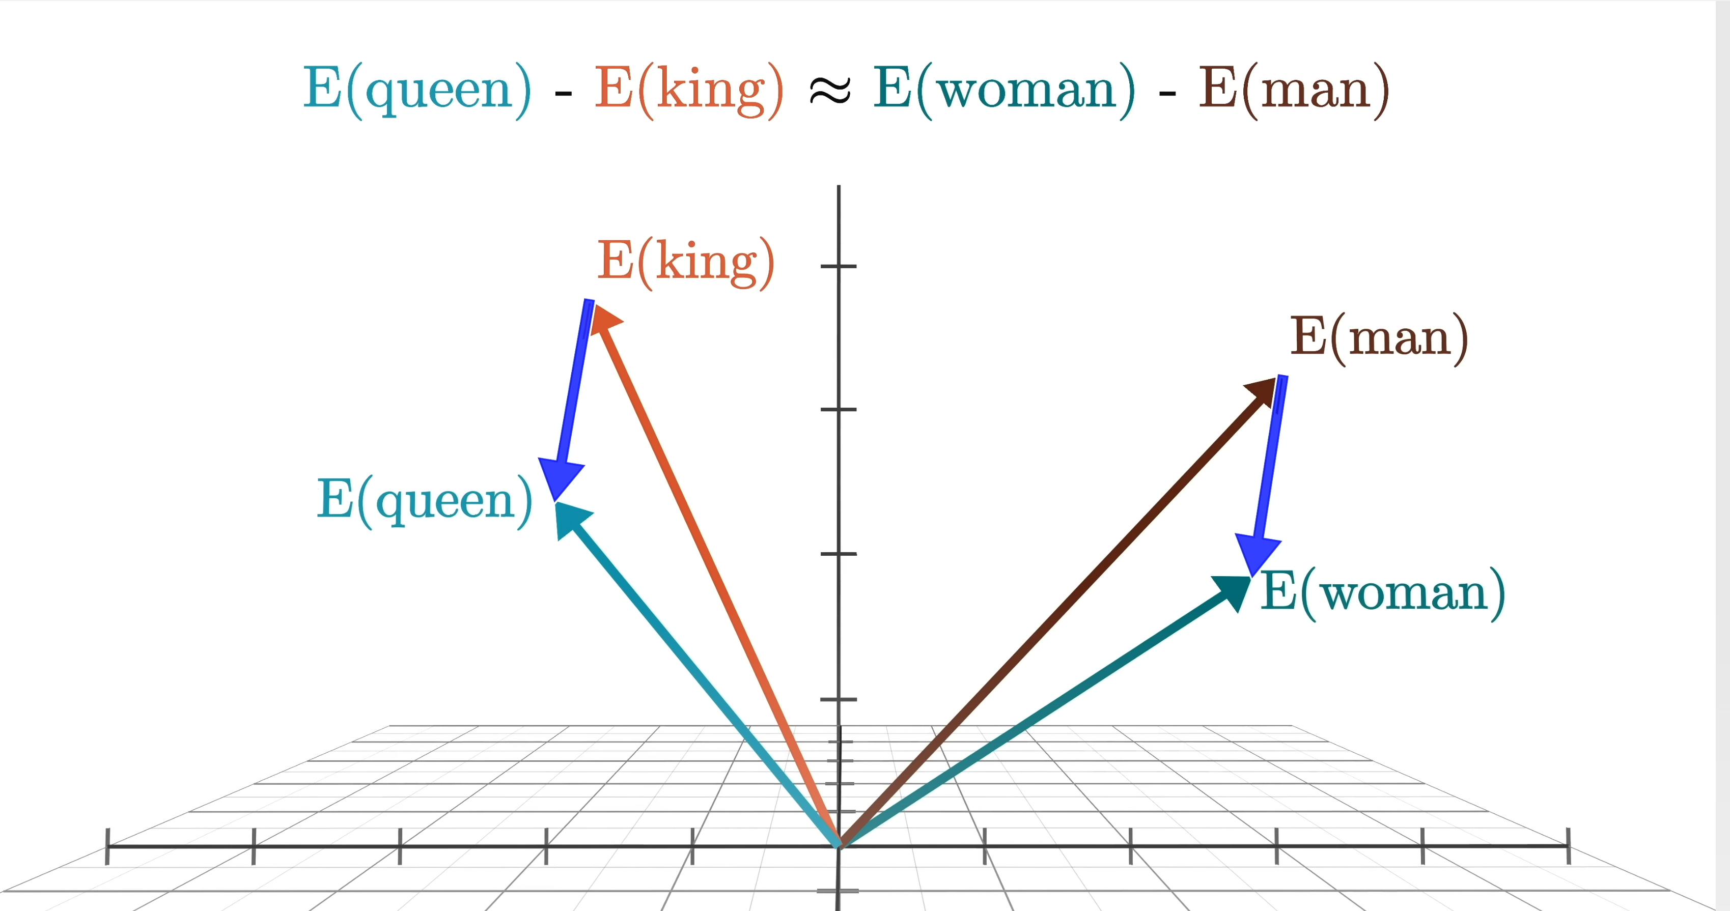
Token Vectors have meaning
female-male
female-male

Slide 22
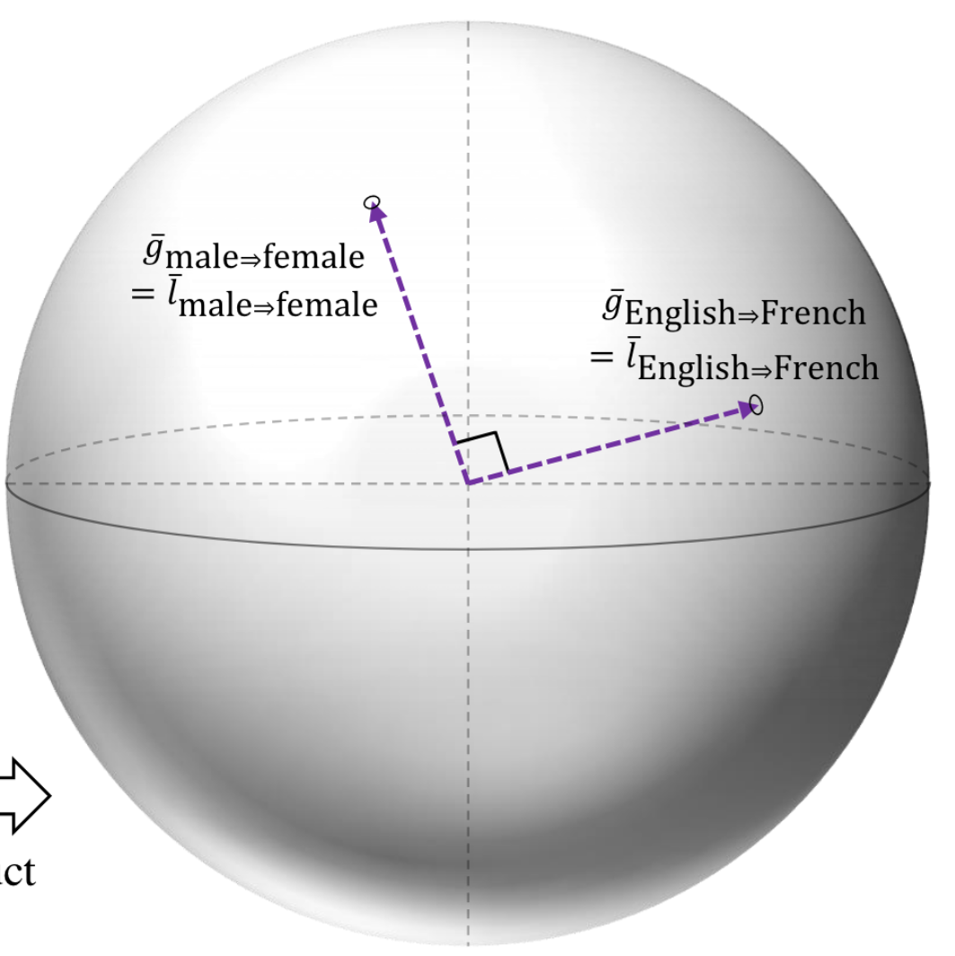
Linear Representation Hypothesis
Difference Vectors are Concept Subspaces.
Unrelated concepts = orthogonal subspaces.

Slide 23
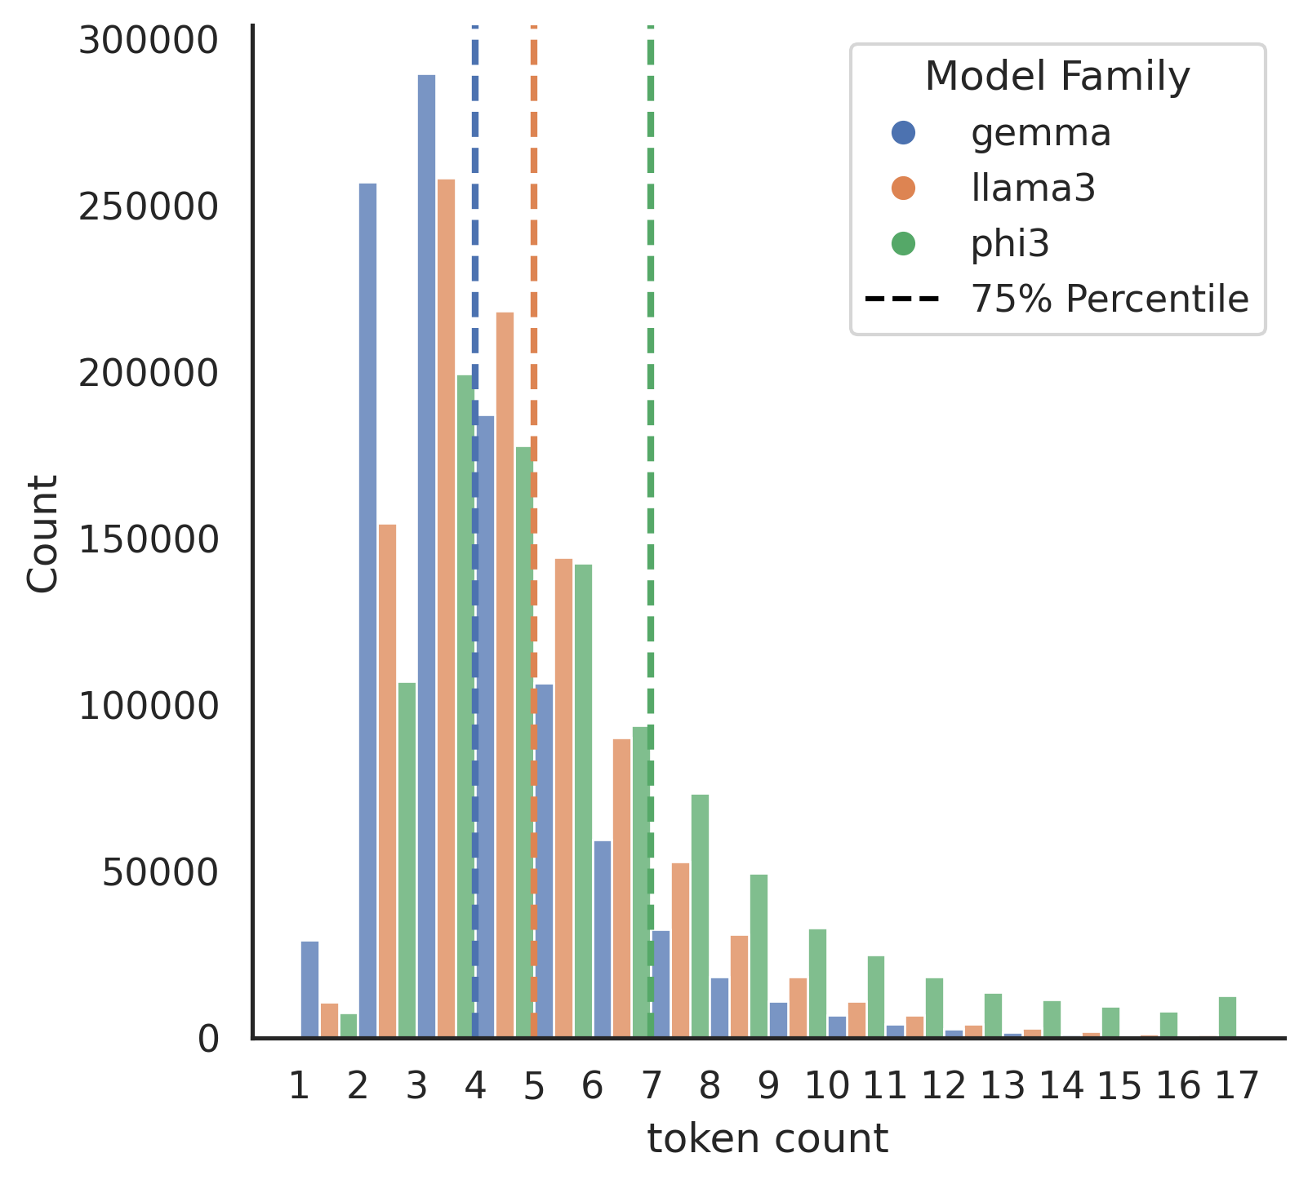
Limitations of LRH
Only works on words made of a single token
< 1%

Slide 24
Limitations of LRH
Only works on 1-dim subspaces
Only works on difference vectors
Then, let’s just make high dimensional subspaces and difference subspaces

Slide 25
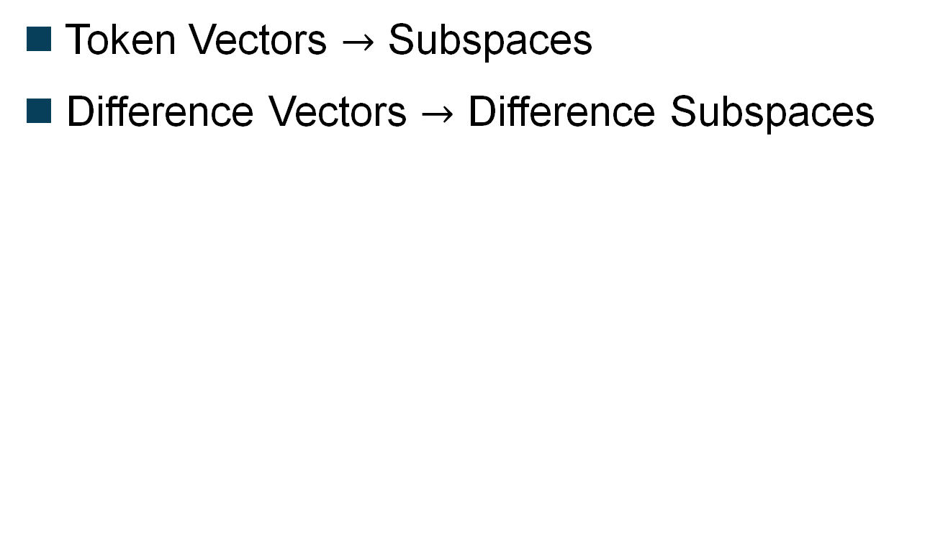
Our Hypothesis
Token Vectors $→$ Subspaces
Difference Vectors $→$ Difference Subspaces

Slide 26
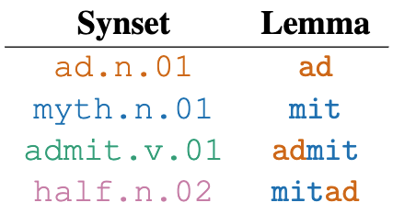
Problem: We need to keep order.
Meaning
Word
“Admit” and “Mitad” would
be the same subspace even
though have different concepts

Slide 27
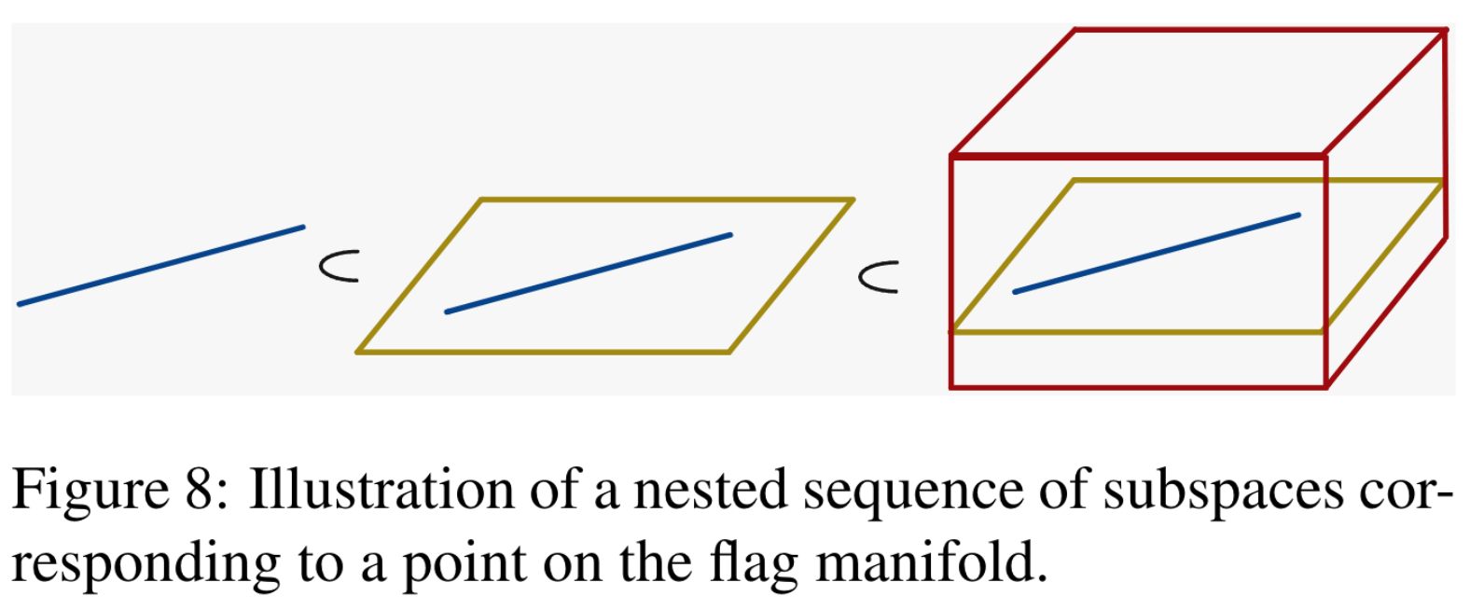
How to make subspaces with order?
Flag = Sequence of subspaces
Cam
Camember
Camembert

Slide 28

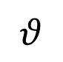
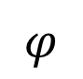
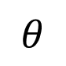
Tokens
Words
Concepts (Synsets)
accept.v.05
half.n.02
admit
admit
mit
mitad
ad
mitad
$$φ$$
recognize
$$φ$$
$$θ$$
Subspaces
Flags
accept
half
accept.v.05 - half.n.02
flag mean
accept.v.05
difference
half.n.02
$$θ$$
Higher Level Concept Flags
Concept Flags

Slide 29
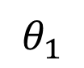
Concept Probing
H
S
$$θ_{1}$$
$$p\left(y_{i} | x\right)∝e^{h {\left(x\right)}^{T}u(y_{i})}$$

Slide 30

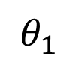
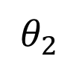
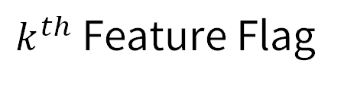
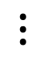
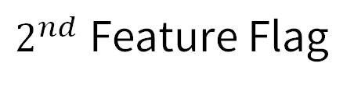
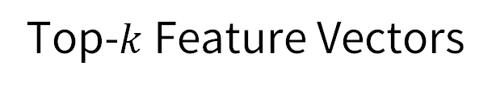
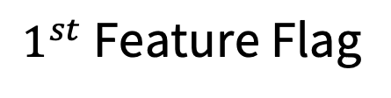
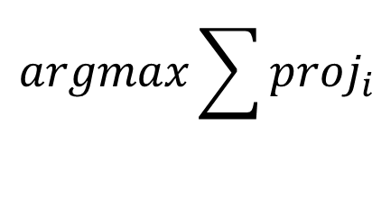
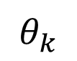
Top-$k$ Feature Vectors
LLM
Input feature vectors
$$⋮$$
Output feature vector
}
Text
Input
Concept Flag
$1^{st}$ Feature Flag
$$argmax\sum{proj_{i}}$$
Unembedding
Space
$$θ_{1}$$
$$θ_{k}$$
$$θ_{2}$$
$k^{th}$ Feature Flag
$$⋯$$
$2^{nd}$ Feature Flag

Slide 31

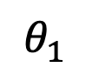
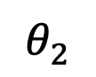
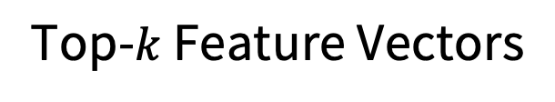
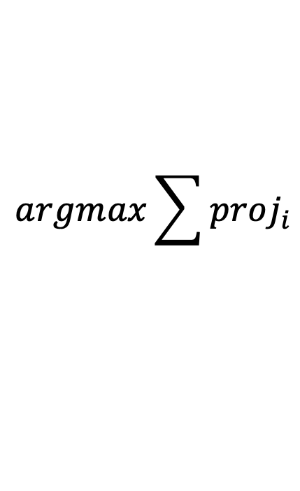
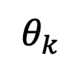
Top-$k$ Feature Vectors
LLM
fruits
Input feature vectors
$$⋮$$
beef
Output feature vector
}
I like
fruits
chicken
Vegetarian
chicken
$$argmax\sum{proj_{i}}$$
Unembedding
Space
$$θ_{1}$$
$$θ_{k}$$
$$θ_{2}$$
fruits
$$⋯$$
beef

Slide 32
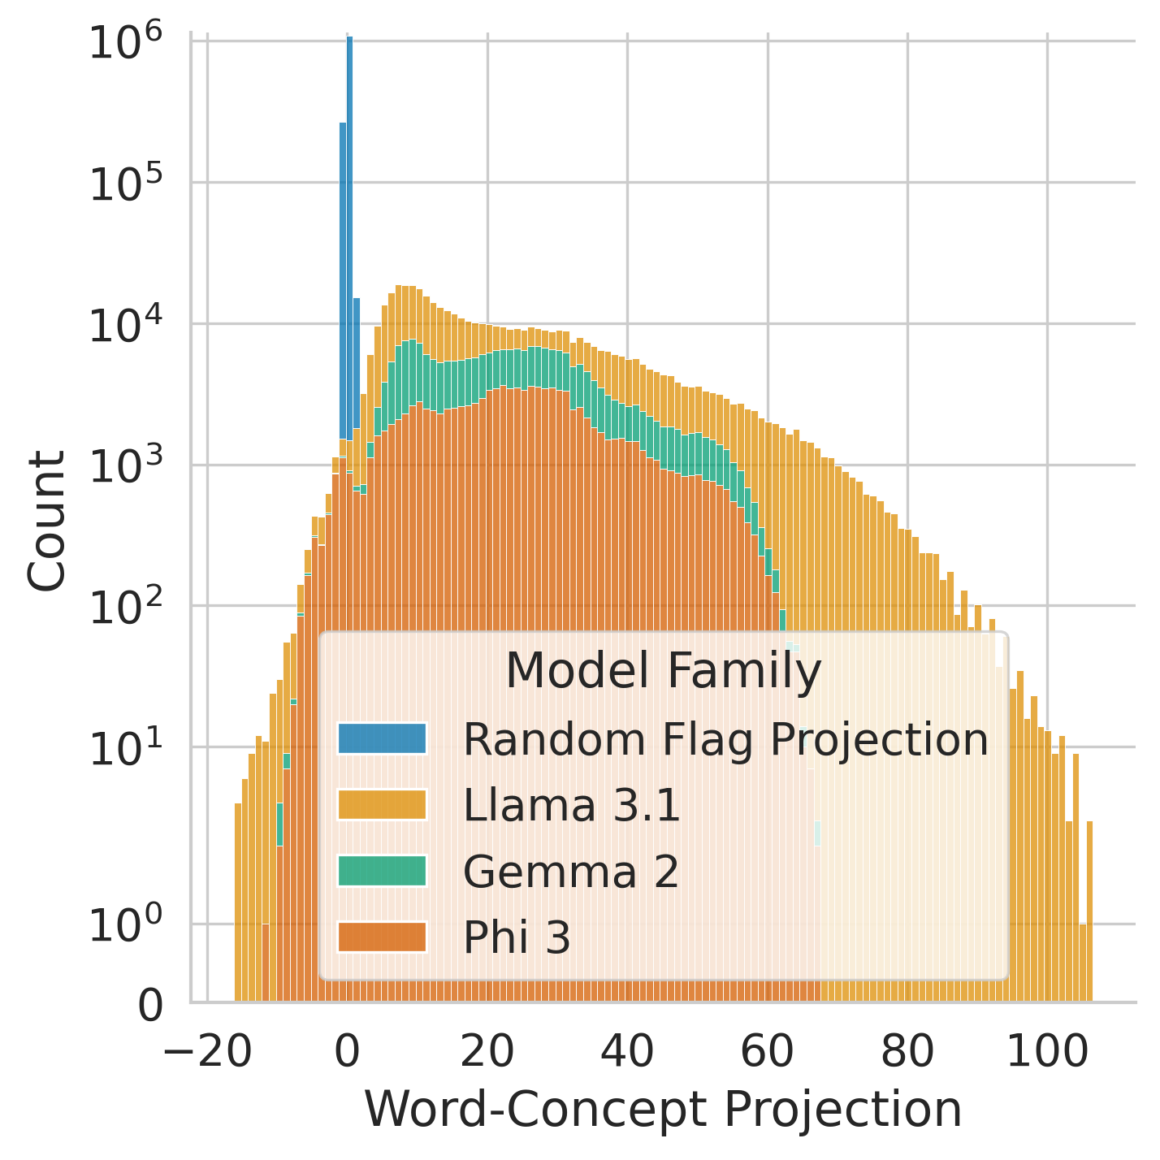
Word-Concept Projection
accept.v.05
admit
recognize
accept
accept.v.05

Slide 33
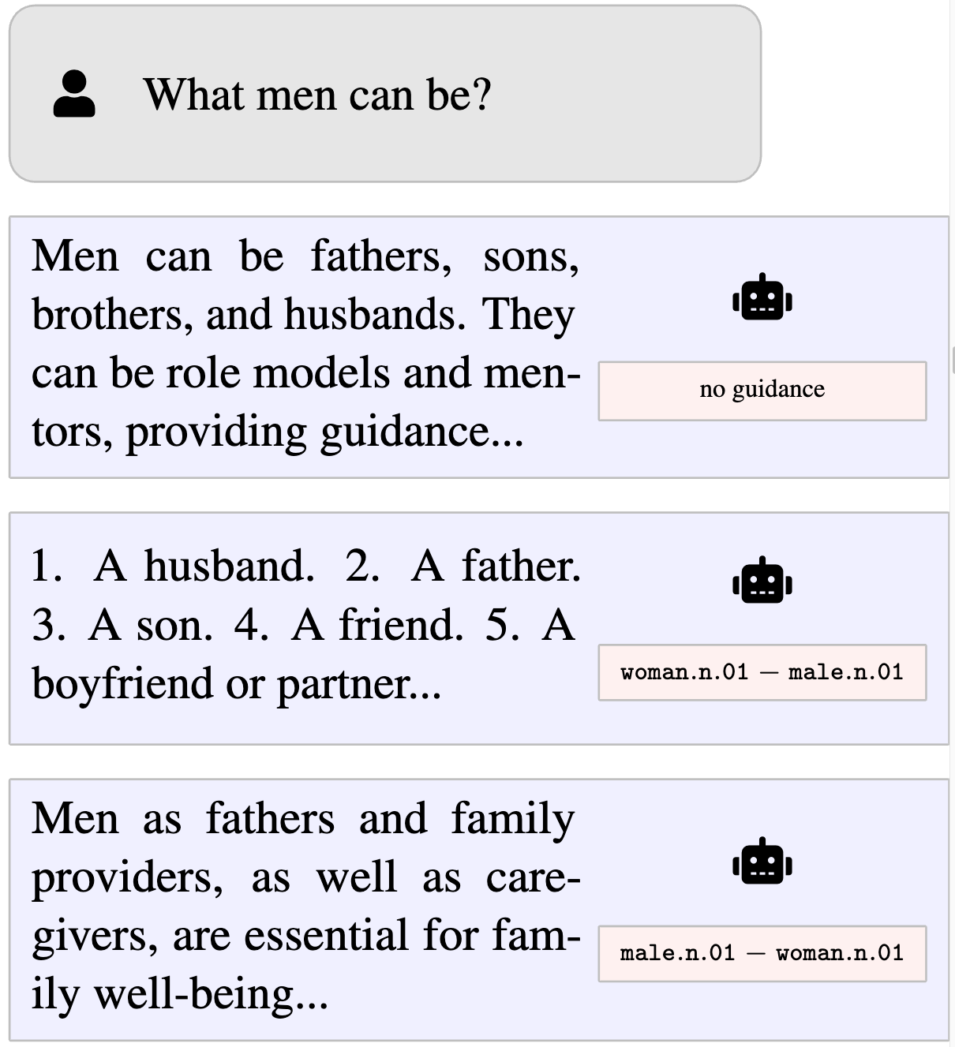
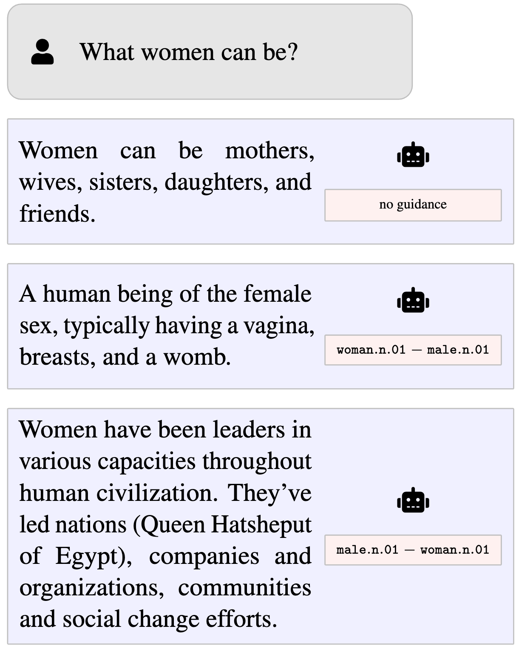
Generation Results

Slide 34
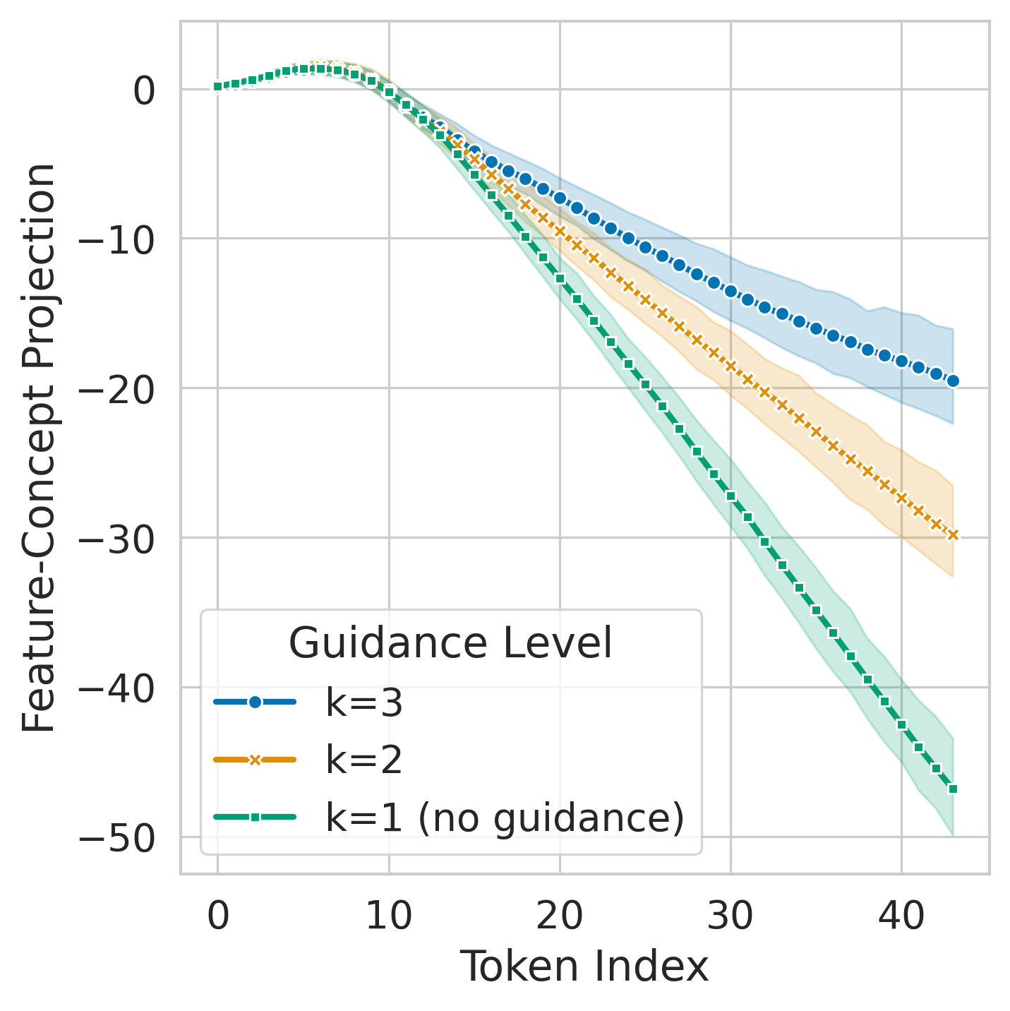
Guidance Ablation
We want to understand the effect of K.
The higher the K, the more positive it becomes.
Conclusion: K controls the guidance strength.

Slide 35
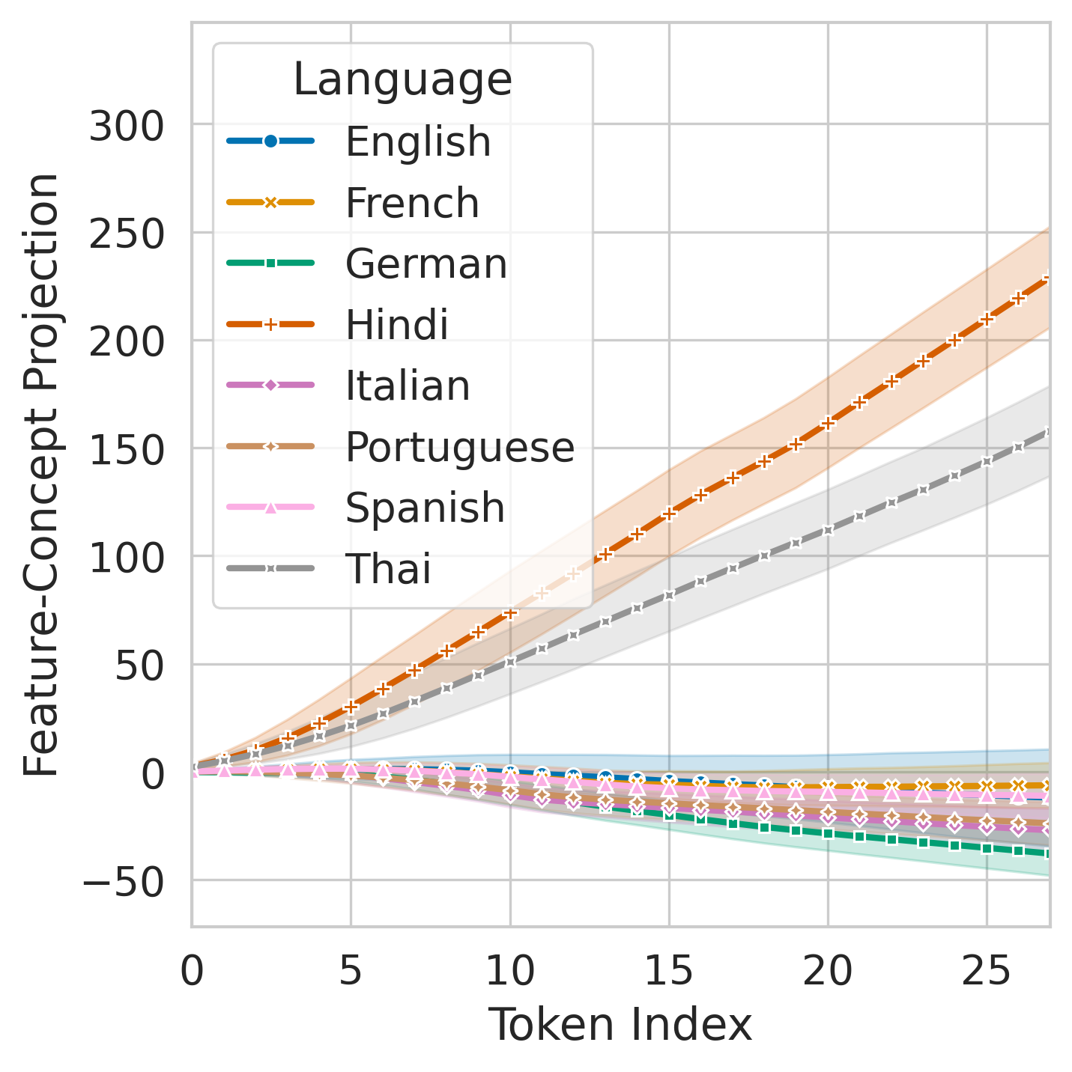
Guidance Ablation
We want to understand the effect on each language.
Conclusion: Hindi and Thai are more susceptible to guidance.

Slide 36
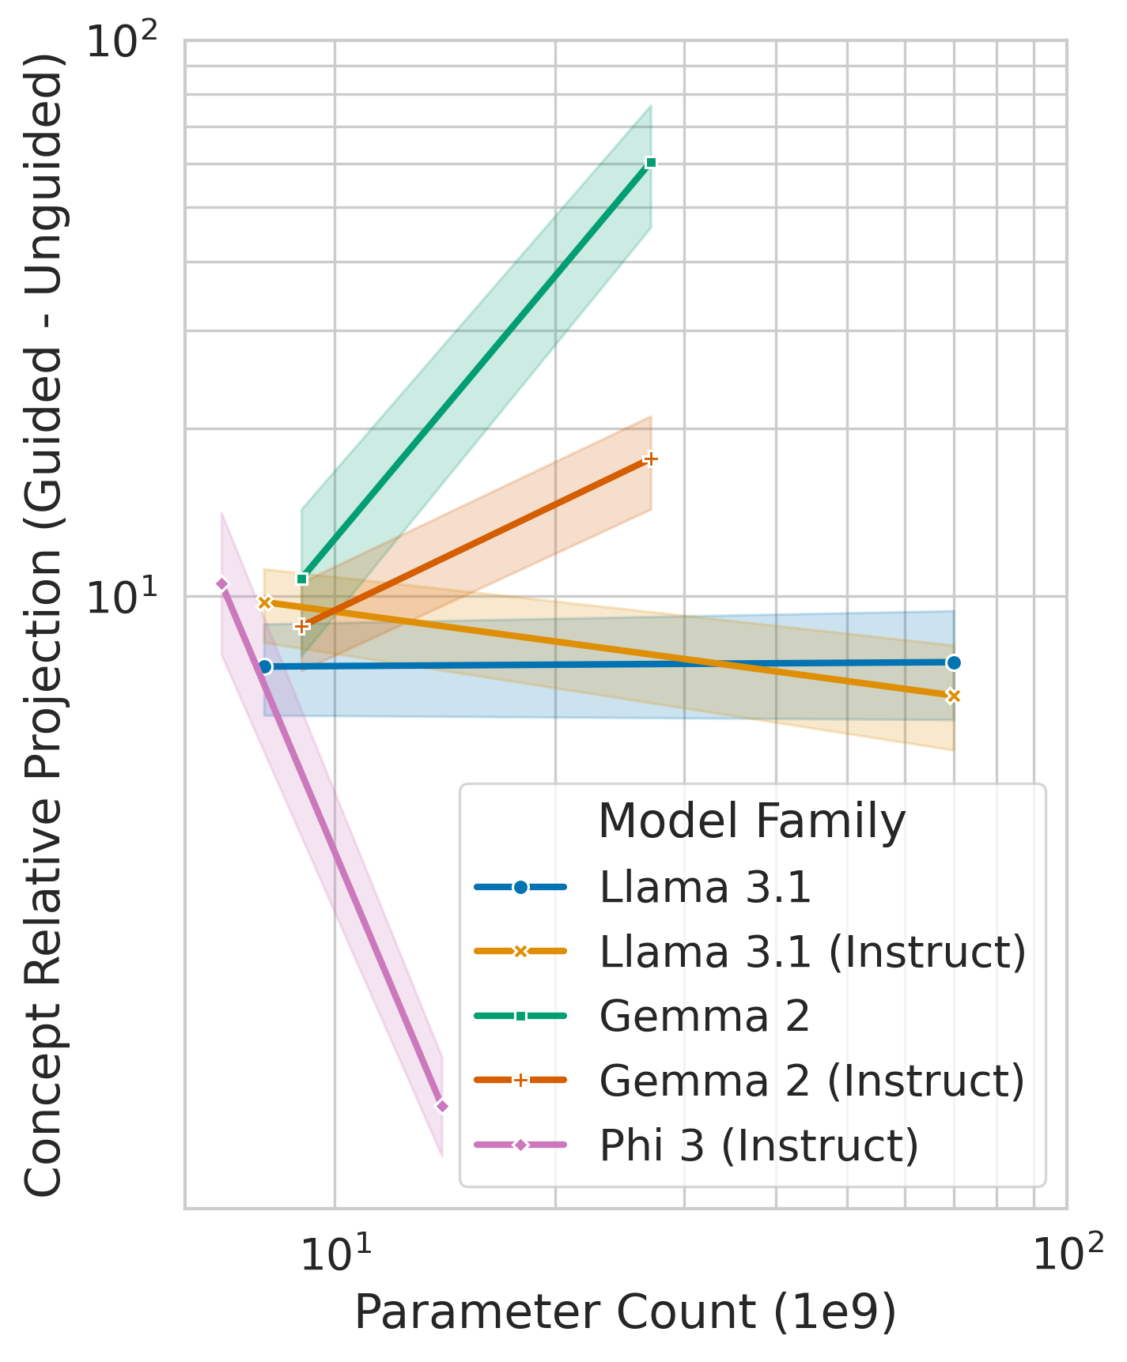
Guidance Ablation
We want to understand the effect on each model.
Conclusion: Gemma is the most susceptible, llama has average susceptibility and Phi the lowest.

Slide 37
Thank you!

